Slide 1


Taeef Najib (https://github.com/taeefnajib)
April 10, 2022

Slide 2

Outline
Executive Summary - 3
Introduction - 4
Methodology - 5
Results
Conclusion
Appendix

Slide 3
Executive Summary
We have collected data from public SpaceX API and by scrapping SpaceX Wikipedia page. Created labels column ‘Class’ which denotes all the successful landings. We performed EDA (Exploratory Data Analysis) using SQL, visualization, folium maps, and dashboards. Then we gathered relevant columns to be used as our features. After that we performed One Hot Encoding and changed all the categorical variables to binary. We standardized data and used GridSearchCV to find the best parameters for our machine learning models. Finally, we visualized the accuracy score of all models.
We used four machine learning models- Logistic Regression, Support Vector Machine (SVM), Decision Tree Classifier, and K Nearest Neighbors. All produced similar results with the accuracy rate of almost 83.33%. All models over predicted successful landings. It is clear that more data is required for a better model determination and accuracy.

Slide 4
Introduction
Background and Context
In this capstone, we will predict if the Falcon 9 first stage will land successfully. SpaceX advertises Falcon 9 rocket launches on its website, with a cost of 62 million dollars; other providers cost upward of 165 million dollars each, much of the savings is because SpaceX can reuse the first stage. Therefore if we can determine if the first stage will land, we can determine the cost of a launch. This information can be used if an alternate company wants to bid against SpaceX for a rocket launch. In this module, you will be provided with an overview of the problem and the tools you need to complete the course. Space Y wants to compete with Space X
Problem at Hand
Space Y tasks us to train a machine learning model to predict successful Stage 1 recovery

Slide 5

Section 1

Slide 6
Methodology
Executive Summary
Data collection methodology:
Gathered data from SpaceX public API and by scrapping SpaceX Wikipedia page
Perform data wrangling
Classifying true landings as successful and unsuccessful otherwise
Perform exploratory data analysis (EDA) using visualization and SQL
Perform interactive visual analytics using Folium and Plotly Dash
Perform predictive analysis using classification models
We tuned the models using GridSearchCV

Slide 7
Data Collection
Data collection process involved a combination of API requests from Space X public API and web scraping data from a table in Space X’s Wikipedia entry.
The next slide will show the flowchart of data collection from API and the one after will show the flowchart of data collection from webscraping.
Space X API Data Columns:
FlightNumber, Date, BoosterVersion, PayloadMass, Orbit, LaunchSite, Outcome, Flights, GridFins, Reused, Legs, LandingPad, Block, ReusedCount, Serial, Longitude, Latitude
Wikipedia Webscrape Data Columns:
Flight No., Launch site, Payload, PayloadMass, Orbit, Customer, Launch outcome, Version Booster, Booster landing, Date, Time

Slide 8
Data Collection – SpaceX API
.JSON file + Lists(Launch Site, Booster Version, Payload Data)
Json_normalize to DataFrame data from JSON
Request (Space X APIs)
Dictionary relevant data
Imputate missing PayloadMass values with mean
Filter data to only include Falcon 9 launches
Cast dictionary to a DataFrame
GitHub URL:
https://github.com/taeefnajib/IBM-Applied-Data-Science-Capstone/blob/main/Data%20Collection%20Using%20API.ipynb

Slide 9
Data Collection - Scraping
GitHub URL:
https://github.com/taeefnajib/IBM-Applied-Data-Science-Capstone/blob/main/Data%20Collection%20Using%20API.ipynb
Request Wikipedia HTML
BeautifulSoup html5lib Parser
Find launch info
HTML table
Iterate through table cells to extract data to dictionary
Cast dctionary to DataFrame
Create
Dictionary

Slide 10
Data Wrangling
Create a training label with landing outcomes where successful = 1 & failure = 0.
Outcome column has two components: ‘Mission Outcome’ ‘Landing Location’
New training label column ‘class’ with a value of 1 if ‘Mission Outcome’ is True and 0 otherwise.
Value Mapping:
True ASDS, True RTLS, & True Ocean – set to -> 1
None None, False ASDS, None ASDS, False Ocean, False RTLS – set to -> 0
GitHub URL:
https://github.com/taeefnajib/IBM-Applied-Data-Science-Capstone/blob/main/Data%20Wrangling.ipynb

Slide 11
EDA with Data Visualization
Exploratory Data Analysis performed on variables Flight Number, Payload Mass, Launch Site, Orbit, Class and Year.
Plots Used:
Flight Number vs. Payload Mass, Flight Number vs. Launch Site, Payload Mass vs. Launch Site, Orbit vs. Success Rate, Flight Number vs. Orbit, Payload vs Orbit, and Success Yearly Trend
Scatter plots, line charts, and bar plots were used to compare relationships between variables to
decide if a relationship exists so that they could be used in training the machine learning model
GitHub URL:
https://github.com/taeefnajib/IBM-Applied-Data-Science-Capstone/blob/main/EDA%20with%20Visualization.ipynb

Slide 12
EDA with SQL
Loaded data set into IBM DB2 Database.
Queried using SQL Python integration.
Queries were made to get a better understanding of the dataset.
Queried information about launch site names, mission outcomes, various pay load sizes of customers and booster versions, and landing outcomes
GitHub URL:
https://github.com/taeefnajib/IBM-Applied-Data-Science-Capstone/blob/main/EDA%20with%20SQL.ipynb

Slide 13
Build an Interactive Map with Folium
Folium maps mark Launch Sites, successful and unsuccessful landings, and a proximity example to key locations: Railway, Highway, Coast, and City.
This allows us to understand why launch sites may be located where they are. Also visualizes successful landings relative to location.
GitHub URL:
https://github.com/taeefnajib/IBM-Applied-Data-Science-Capstone/blob/main/Interactive%20Visual%20Analytics%20and%20Dashboard.ipynb

Slide 14
Predictive Analysis (Classification)
Split label
column ”Class”
from dataset
Fit and transform features using Standard Scaler
GridSearchCV
(cv=10) to find
Optimal
parameter
Train_test_split data
Use GridSearchCV
on LogReg, SVM,
Decision Tree,
and KNN models
Barplot to compare
Score of models
Confusion
Matrix for all
models
Score models on
split test set
GitHub URL:
https://github.com/taeefnajib/IBM-Applied-Data-Science-Capstone/blob/main/Predictive%20Analysis.ipynb

Slide 15
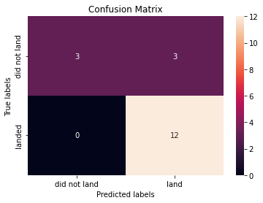
Results
LogReg
Accuracy: 83.33%
SVM
Accuracy: 83.33%
Decision Tree
Accuracy: 83.33%
KNN
Accuracy: 83.33%

Slide 16

Section 2

Slide 17
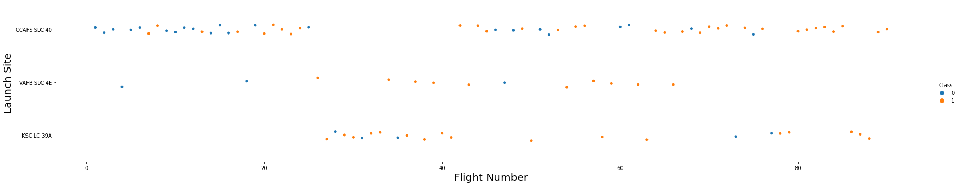
Flight Number vs. Launch Site
Blue indicates successful launch and orange indicates unsuccessful launch. Graphic suggests an increase in success rate over time (indicated in Flight Number). Likely a big breakthrough around flight 20 which significantly increased success rate.
CCAFS appears to be the main launch site as it has the most volume.

Slide 18
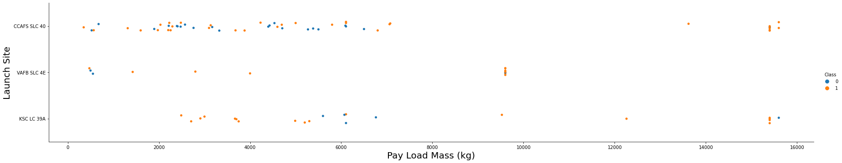
Payload vs. Launch Site
Blue indicates successful launch and orange indicates unsuccessful launch. Payload mass appears to fall mostly between 0-6000 kg. Different launch sites also seem to use different payload mass.

Slide 19
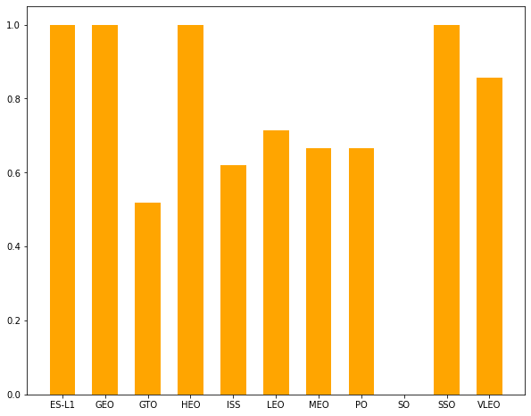
Success Rate vs. Orbit Type
ES-L1 (1), GEO (1), HEO (1) have 100% success rate (sample sizes in parenthesis) SSO (5) has 100% success rate
VLEO (14) has decent success rate and attempts
SO (1) has 0% success rate
GTO (27) has the around 50% success rate but largest sample
Success Rate Scale with 0 as 0%
0.6 as 60% 1 as 100%
Success Rate
Orbit

Slide 20
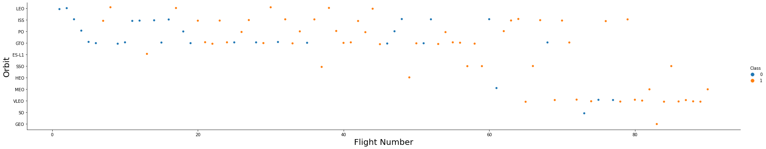
Flight Number vs. Orbit Type
Blue indicates successful launch and orange indicates unsuccessful launch.
Launch Orbit preferences changed over Flight Number.
Launch Outcome seems to correlate with this preference.
SpaceX started with LEO orbits which saw moderate success LEO and returned to VLEO in recent launches
SpaceX appears to perform better in lower orbits or Sun-synchronous orbits

Slide 21
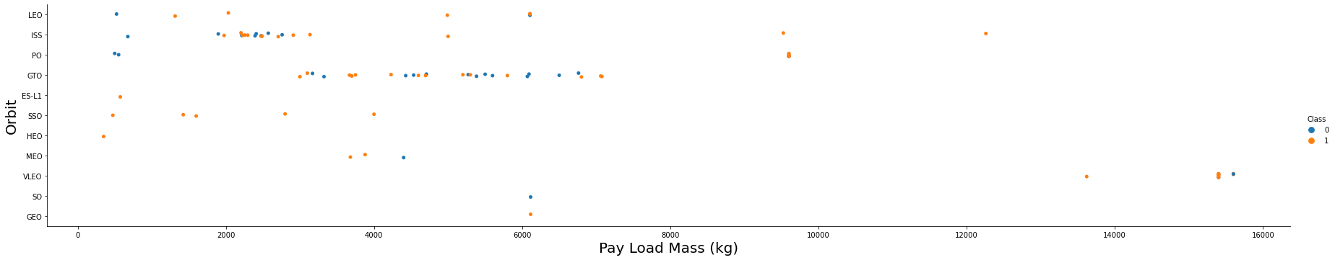
Payload vs. Orbit Type
Blue indicates successful launch and orange indicates unsuccessful launch.
Payload mass seems to correlate with orbit
LEO and SSO seem to have relatively low payload mass
The other most successful orbit VLEO only has payload mass values in the higher end of the range

Slide 22
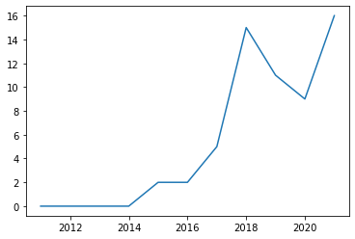
Launch Success Yearly Trend
Success generally increases over time since 2013 with a slight dip in 2018
Success in recent years at around 80%
95% confidence interval (light blue shading)
Success Rate
Year

Slide 23
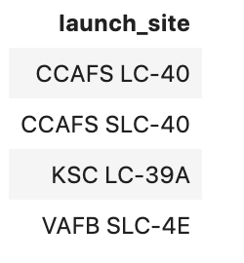
All Launch Site Names
CCAFS LC-40
CCAFS SCL-40
KSC LC-39A
VAFB SLC-4E
% %sql
SELECT DISTINCT LAUNCH_SITE FROM SPACEXDATASET;

Slide 24
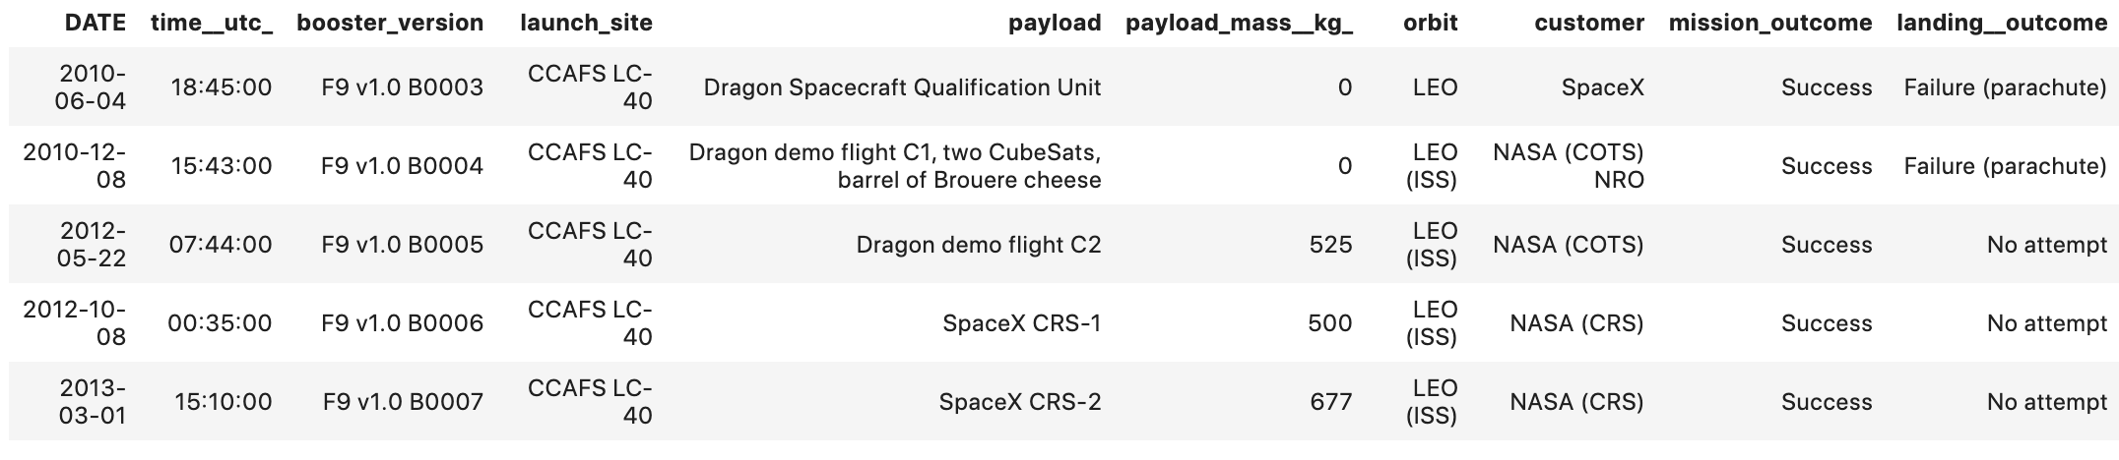
Launch Site Names Begin with 'CCA'
% %sql
SELECT * FROM SPACEXDATASET WHERE LAUNCH_SITE LIKE 'CCA%' LIMIT 5;

Slide 25
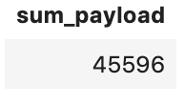
Total Payload Mass
sum_payload:
45596
% %sql
SELECT SUM (payload_mass__kg_) AS SUM_PAYLOAD FROM SPACEXDATASET WHERE customer = 'NASA (CRS)';

Slide 26
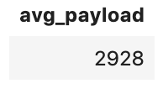
Average Payload Mass by F9 v1.1
avg_payload:
2928
% %sql
SELECT AVG (payload_mass__kg_) AS AVG_PAYLOAD FROM SPACEXDATASET WHERE BOOSTER_VERSION =‘F9 v1.1';

Slide 27
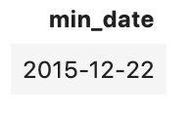
First Successful Ground Landing Date
min_date:
2015-12-22
% %sql
SELECT MIN(DATE) AS MIN_DATE FROM SPACEXDATASET WHERE landing__outcome = 'Success (ground pad)';

Slide 28
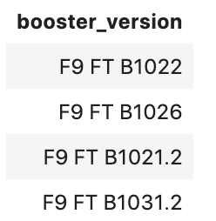
Successful Drone Ship Landing with Payload between 4000 and 6000
% %sql
SELECT booster_version FROM SPACEXDATASET WHERE payload_mass__kg_ > '4000’ AND payload_mass__kg_ < '6000’ AND landing__outcome = 'Success (drone ship)';

Slide 29
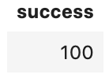
Total Number of Successful and Failure Mission Outcomes
Success: 100
% %sql
SELECT COUNT(*) AS SUCCESS FROM SPACEXDATASET WHERE mission_outcome LIKE 'Success%';

Slide 30
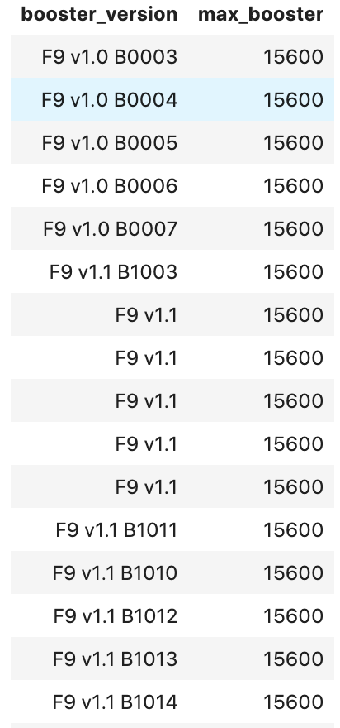
Boosters Carried Maximum Payload
This query returns the booster versions that carried the highest payload mass of 15600 kg.
These booster versions are very similar.
This likely indicates payload mass correlates with the booster version that is used.
% %sql
SELECT booster_version,(SELECT MAX(payload_mass__kg_) FROM SPACEXDATASET) AS MAX_Booster FROM SPACEXDATASET ;

Slide 31
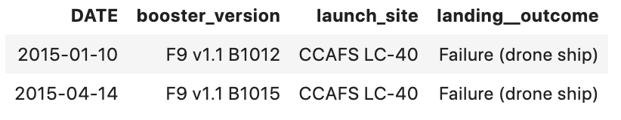
2015 Launch Records
% %sql
SELECT Date, booster_version, launch_site,landing__outcome FROM SPACEXDATASET WHERE landing__outcome = 'Failure (drone ship)’ AND YEAR(Date) = 2015;

Slide 32
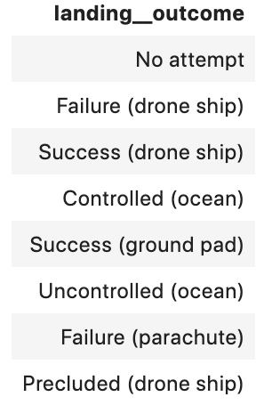
Rank Landing Outcomes Between 2010-06-04 and 2017-03-20
% %sql
SELECT landing__outcome FROM SPACEXDATASET WHERE Date > '2010-06-04' AND Date < '2017-03-20' GROUP BY landing__outcome ORDER BY COUNT(landing__outcome) DESC;

Slide 33

Section 3

Slide 34

Launch Site Locations
The left map shows all launch sites relative US map. The right map shows the two Florida launch sites since they are very close to each other. All launch sites are near the ocean.

Slide 35

Color Coded Launch Markers
Clusters on Folium map can be clicked on to display each successful landing (green icon) and failed landing (red icon). In this example VAFB SLC-4E shows 4 successful landings and 6 failed landings.

Slide 36



Key Location Proximities
Using KSC LC-39A as an example, launch sites are very close to railways for large part and supply transportation. Launch sites are close to highways for human and supply transport. Launch sites are also close to coasts and relatively far from cities so that launch failures can land in the sea to avoid rockets falling on densely populated areas.

Slide 37

Section 5

Slide 38
Classification Accuracy
All models had virtually the same accuracy on the test set at 83.33% accuracy. It should be noted that test size is small at only sample size of 18.
This can cause large variance in accuracy results, such as those in Decision Tree Classifier model in repeated runs.
We likely need more data to determine the best model.

Slide 39

Confusion Matrix
Correct predictions are on a diagonal from top left to bottom right.
Since all models performed the same for the test set, the confusion matrix is the same across all models. The models predicted 12 successful landings when the true label was successful landing.
The models predicted 3 unsuccessful landings when the true label was unsuccessful landing.
The models predicted 3 successful landings when the true label was unsuccessful landings (false positives). Our models over predict successful landings.

Slide 40
Conclusions
Our task: to develop a machine learning model for Space Y who wants to bid against SpaceX
The goal of model is to predict when Stage 1 will successfully land to save ~$100 million USD
Used data from a public SpaceX API and web scraping SpaceX Wikipedia page
Created data labels and stored data into a DB2 SQL database
Created a dashboard for visualization
We created a machine learning model with an accuracy of 83%
Allon Mask of SpaceY can use this model to predict with relatively high accuracy whether a launch will have a successful Stage 1 landing before launch to determine whether the launch should be made or not
If possible more data should be collected to better determine the best machine learning model and improve accuracy

Slide 41
Appendix
GitHub Repository URL:
https://github.com/taeefnajib/IBM-Applied-Data-Science-Capstone
Instructors:
Rav Ahuja, Alex Aklson, Aije Egwaikhide, Svetlana Levitan, Romeo Kienzler, Polong Lin, Joseph Santarcangelo, Azim Hirjani, Hima Vasudevan, Saishruthi Swaminathan, Saeed Aghabozorgi, Yan Luo
Special Thanks to All Instructors:
https://www.coursera.org/professional-certificates/ibm-data-science?#instructors

Slide 42


